Slide 1

Malicious URL Detection
Lakshmi Vineela Peri (Fall 2017)

Slide 2
Introduction
What is Phishing and what is the impact
Phishing is the attempt to obtain sensitive information such as usernames, passwords, and credit card details (and money), often for malicious reasons, by disguising as a trustworthy entity in an electronic communication.
Phishing is typically carried out by email spoofing[4] or instant messaging, and it often directs users to enter personal information at a fake website, the look and feel of which are identical to the legitimate one and the only difference is the URL of the website in concern. Phishing emails may contain links to websites that are infected with malware.
According to the 2013 Microsoft Computing Safety Index, released in February 2014, the annual worldwide impact of phishing could be as high as US$5 billion.

Slide 3
Scope:
Problem:
Identifying malicious Uniform Resource Locators (URL) can help protect users from losing sensitive data. URLs are the primary means by which users locate resources on the Internet.
Solution:
The goal is to detect malicious websites from the lexical and host-based features of their URLs leveraging binary classification where positive examples are malicious URLs and negative examples are benign URLs.

Slide 4
Dataset and Features
Host name
Data Set
500,000 URLs from Virus Total
375,786 benign urls
124,214 malicious urls
Types of features
Semantic features (only from name of URL itself)
Meta features (from external sources: WHOIS, etc)
Content features (inside URL – is html page of exe)
Protocol
http://www.subdomain.domain.com/webapp.php?param=234
Top level domain
Path
Primary domain

Slide 5
Implementation
Models implemented & Trained
Decision Trees
RandomForest
NaiveBayes
Logistic regression
Accuracy Result:

Slide 6
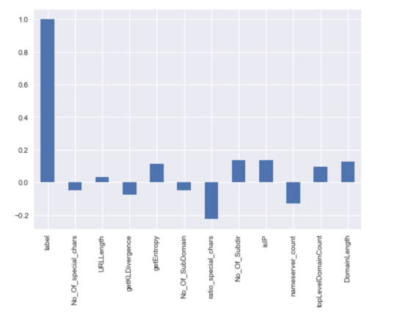
Implementation contd…
Additional analysis on generated features
Ranking
Correlation between the label and the features.
Feature weights (Info gain) with help of RandomForest
Constructed a dataframe from this scaled model to further improve the NaiveBayes Model accuracy to 75%

Slide 7
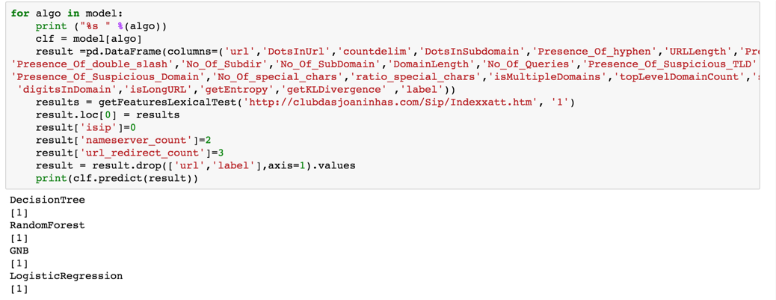
Testing the model:

Slide 8
TF-IDF and Logistic Regression
Created a custom tokenizer function to tokenize the URL’s.
Vectorize URLs using TFIDFVectorizer using the custom tokenizer function .
Split the data and use it to train the LogisticRegression.
Accuracy with this training model is 90.6985%

Slide 9
References:
Malicious URL Detection using Machine Learning
https://arxiv.org/pdf/1701.07179.pdf
Using Machine Learning to Detect Malicious URLs
https://www.kdnuggets.com/2016/10/machine-learning-detect-malicious-urls.html
Detecting malicious URLs using machine learning techniques
http://ieeexplore.ieee.org/document/7850079/
Beyond Blacklists: Learning to Detect Malicious Web Sites from Suspicious URLs.
http://www.cs. berkeley.edu/∼jtma/papers/beyondbl-kdd2009.pdf
Code References: GITHUB examples.
https://github.com/nikbearbrown/NEU_COE/blob/master/CSYE_7245/Week_3/

Slide 10
Future Scope
Implement Deep Neural Network model with inputs from
https://arxiv.org/pdf/1702.08568.pdf
The URL problem can be formulated as a character sequence.
Train the model to identify relationships between characters in a sequence to distinguish between
BAD - http:\\31.14.136.202\secure.apple.id.login\Apple\login.php
and
GOOD - https:\\applied.apple.com\#!&page=signin
Experimentation with Shallow model showed promising results.

Slide 11
QUESTIONS

